Slide 1
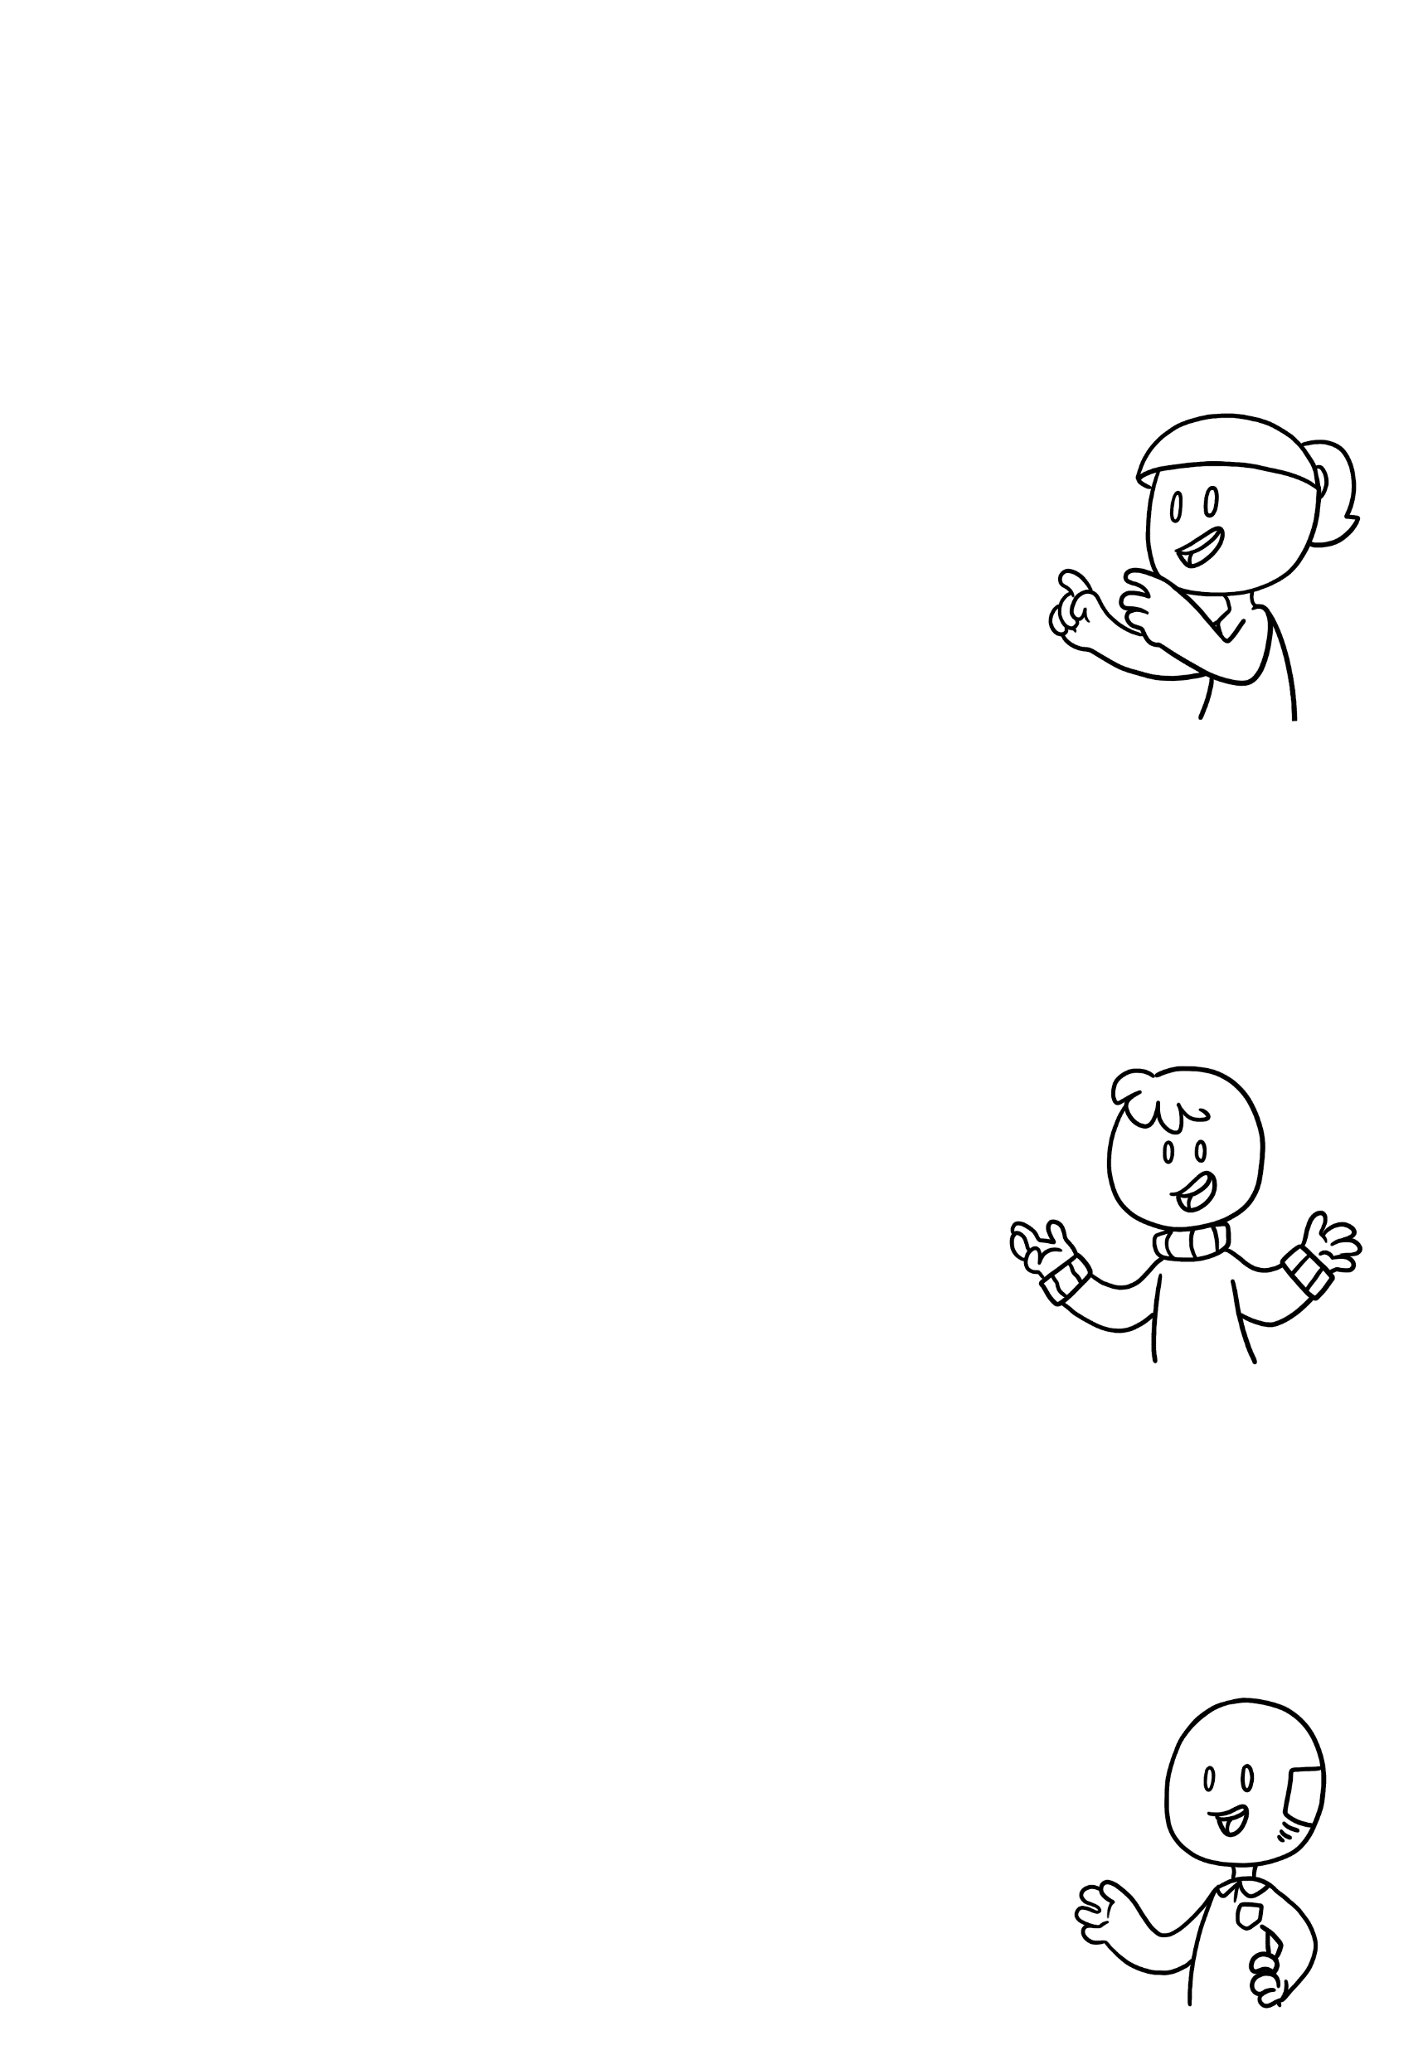
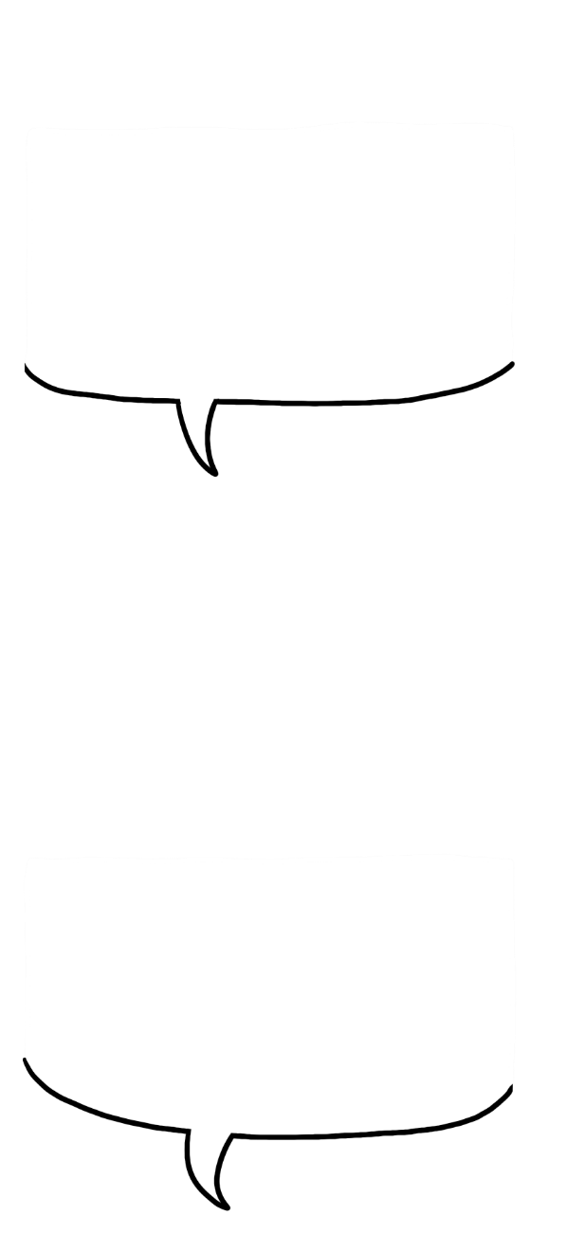

Comixplain Template
These are single panels. You can have a comic strip with three of them side by side. You can create one by adding a text box with a width of 2.24" and a height of 3.23".
SINGLE
SINGLE
You can use a double-sized panel to display a larger image, present a longer description, or just take more time with a concept than you would in a single panel. It has a width of 4.65“.
DOUBLE
TRIPLE
You can use a triple-sized panel for a larger scene. It has 7". You can create any panel by adding a text box with a back outline.
1

